Slide 1
Decision Graph Embedding for High-Resolution Manometry Diagnosis
Julian Kreiser, Alexander Hann, Eugen Zizer, Timo Ropinski
By: Bryce Maldonado

Slide 2
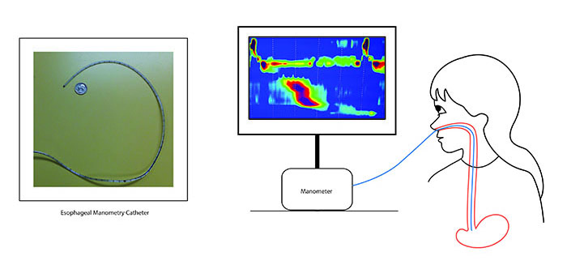
Pertinent information
Esophageal manometry
Manometry = evaluation of pressure
Esophageal = esophagus
Chicago Classification v3.0 (CC3)
Gold standard for HRM diagnosis
Used for diagnosing diseases such as:
Achalasia
Distal esophageal spasm
Ineffective esophageal motility

Slide 3
Proposal
A new visualization technique for HRM diagnosis based on CC3 to:
Alleviate the current diagnosis workflow which is both time consuming and requires full concentration, making diagnosis more efficient.
Solve the current eyes-beat-memory workflow and allowing for a more effective diagnosis.
Allow for visual comparison between groups of patients, making diagnosis more relatable.

Slide 4
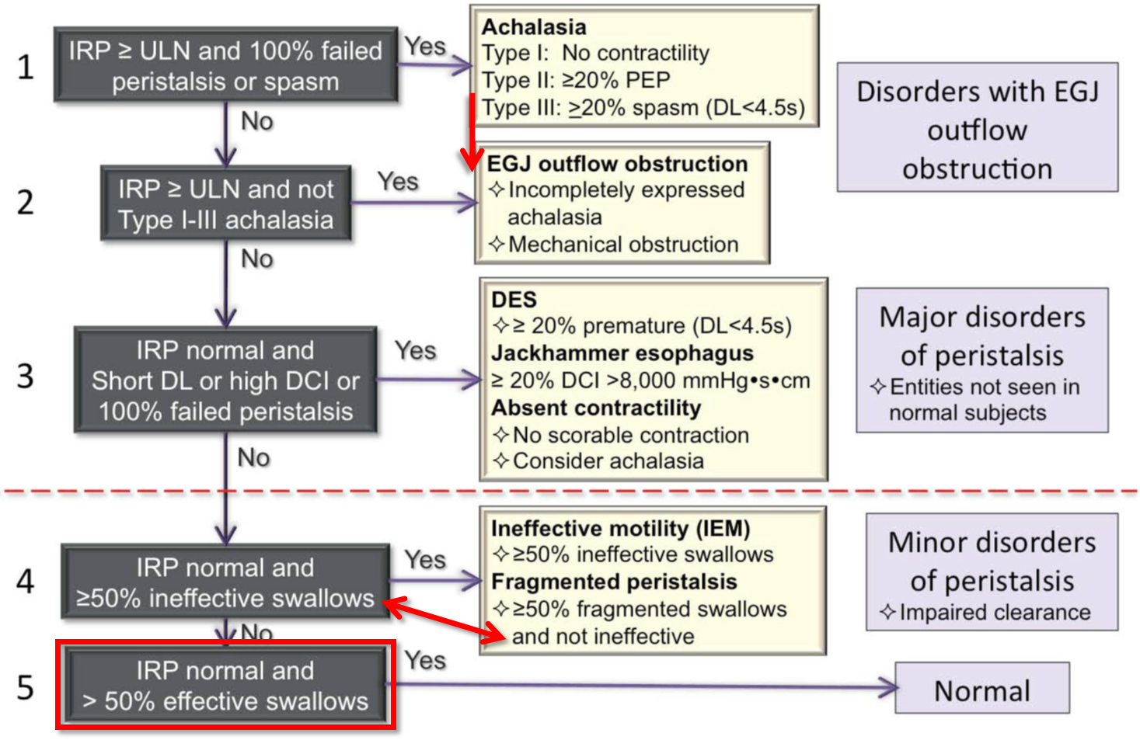
Traditional Workflow
Severity of diagnosis decreases from top to bottom
Contains an unnecessary node and a contradiction
Diagnosis is based off of 6 main attributes
Integrated Relaxation Pressure(IRP)
Distal Contractile Intergral (DCI)
Distal Latency (DL)
Contractile Deceleration Point (CDP)
Panesophageal Pressurization (PEP)
Fragmentation

Slide 5
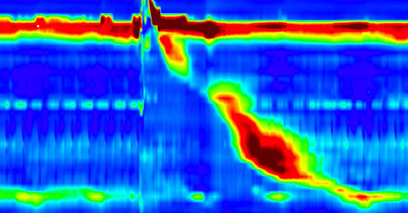
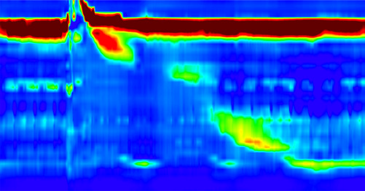
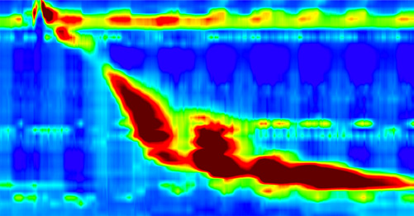
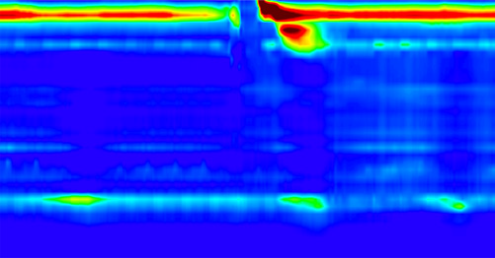
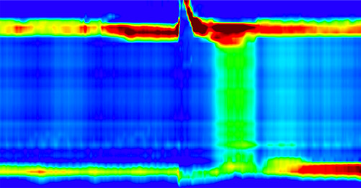
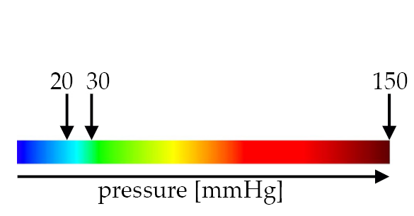
Traditional Visualization
Healthy
Fragmented Peristalsis
Jackhammer Esophagus
Achalasia Type I
Achalasia Type II

Slide 6
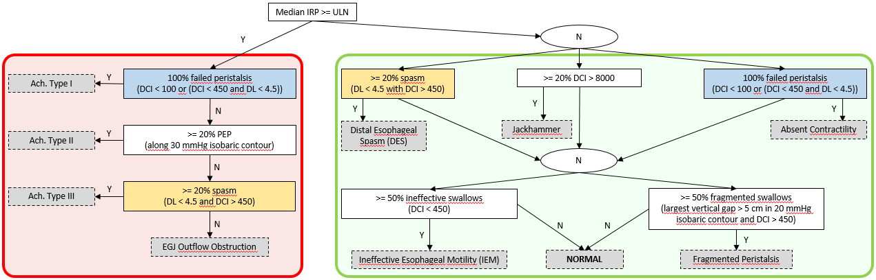
New Workflow

Slide 7
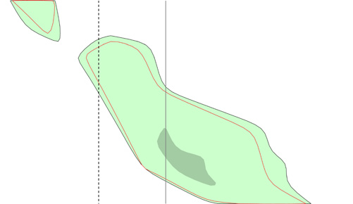

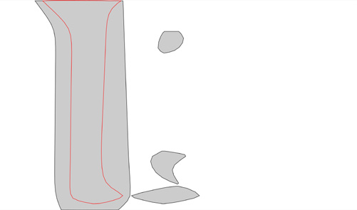
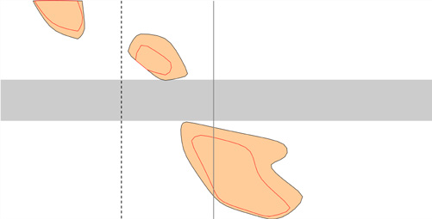
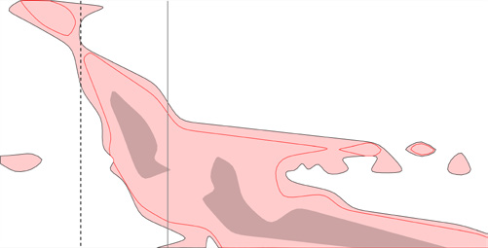
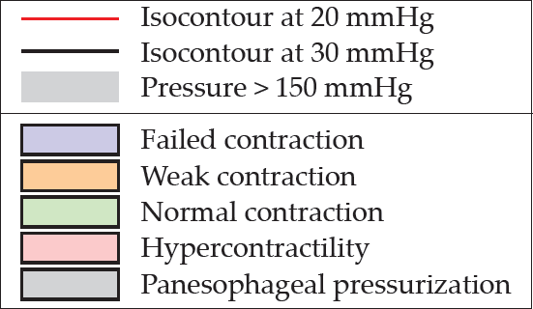
New Single Swallow Visualization
Abstracts data to emphasize key attributes based on the workflow diagram
Color coded DCI
Easily visible DL
Identifiable fragmentation
IRP not included
Benefits
Removes artifacts from old visualization
More effective use of color, less cluttered data

Slide 8
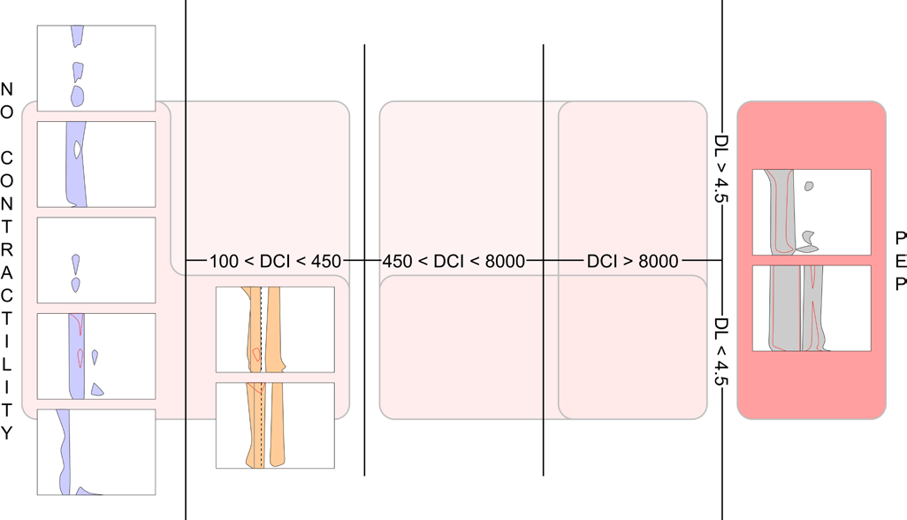
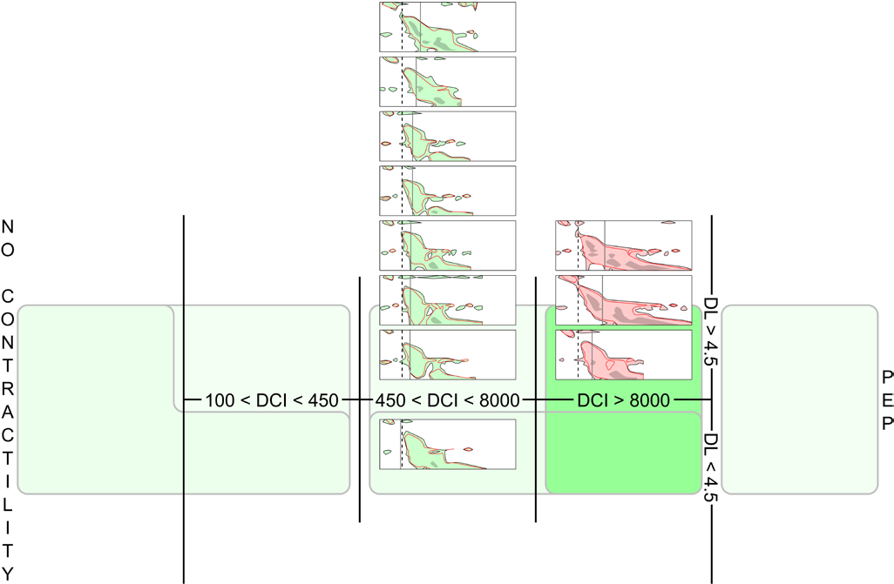
New Multiple Swallows Visualization
IRP determines the color of a graph. Severe afflictions are diagnosable at a first glance. Allows for multiple swallows to be placed next to each other for easy visual comparison. Saturated areas relate to specific diseases based on key attributes. Single swallows are compactable.

Slide 9
Effectiveness Analysis
Comparative study
7 Medical students with an average of 9.8 semesters completed (close to the end of their studies)
Each student was confronted with 10 cases, and used each tool for 5 cases
One student correctly diagnosed all cases with the traditional visualization
Three students correctly diagnosed all cases with the new visualization technique
Traditional analysis required 46.2s, new analysis required 73.3s (half knew traditional method already)
4 students commented cognitive load with new technique would be less over time as they used it
Qualitative Evaluation
An independent expert in manometry diagnosis
Over 330 esophageal manometry procedures in the last decade
It’s obvious how to read the workflow if someone is familiar with CC3
Additional information beyond the CC3 information would be nice (other symptoms, accustoming)
Abstract view can help with starting direction of diagnosis but shouldn’t be blindly trusted
Actively using it for diagnosis is the best test of accuracy and efficiency

Slide 10
Limitations and Solutions
Red-green colorblindness
Use a red-blue color scheme
Visualization space is not optimally utilized if all swallows fall in a single section, even when they are collapsable
Symptomatology is left out of the diagnostic process
Allow for the overlay of annotative notes
Patients not accustomed to the catheter may not have normal swallows or may take time to get accustomed to swallowing with the catheter
Annotative notes and perhaps number each individual swallow
Results are based on small qualitative feedback
Conduct much larger expert evaluation in the future

Slide 11
Bibliography
[1] J. Kreiser, A. Hann, E. Zizer, and T. Ropinski, “Decision Graph Embedding for High-Resolution Manometry Diagnosis,” vol. 24, no. 1, pp. 873–882, 2018.
[2] https://www.gikids.org/content/117/en/esophageal-manometry

